Slide 1
Key Terms for Section 1
These terms must be included in your foldable for home work
Seismology
Deformation
Elastic rebound
Seismic waves
P waves
S waves

Slide 2
What are Earthquakes?
The shaking or trembling caused by the sudden release of energy
Usually associated with faulting or breaking of rocks
Continuing adjustment of position results in aftershocks

Slide 3
What are Earthquakes?
Seismology – the study of Earthquakes
Seismologists – scientists who study Earthquakes

Slide 4
What causes Earthquakes?
As plates push, pull, or slip past each other, stress increases along faults.
Deformation is a result of the stress
Deformation – the change to the shape of rock in response to stress

Slide 5
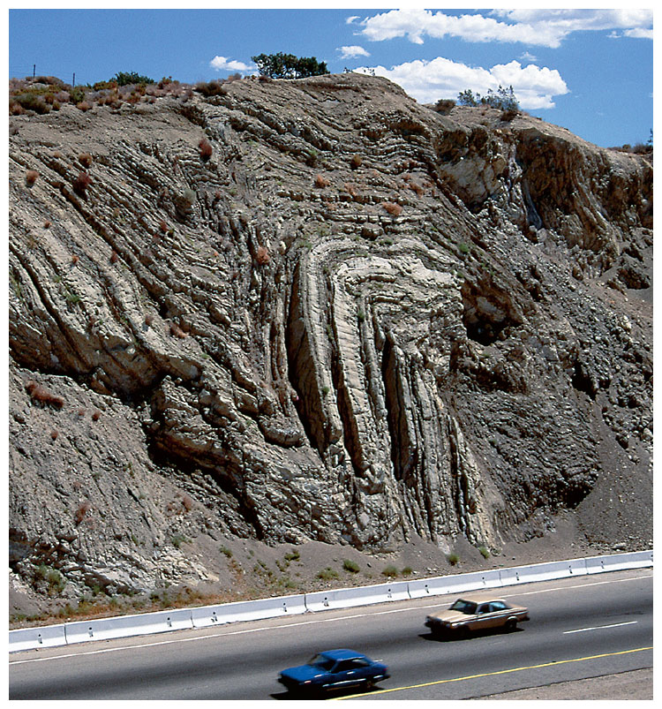
Two Types of Deformation
Plastic Deformation
Deforms like a piece of molded clay
Does not cause Earthquakes

Slide 6
Two Types of Deformation
Elastic Deformation
Deforms like a rubber band
Leads to Earthquakes
Rock keeps stretching until it finally breaks
When it breaks energy is released
Broken pieces return to their unstretched shape

Slide 7
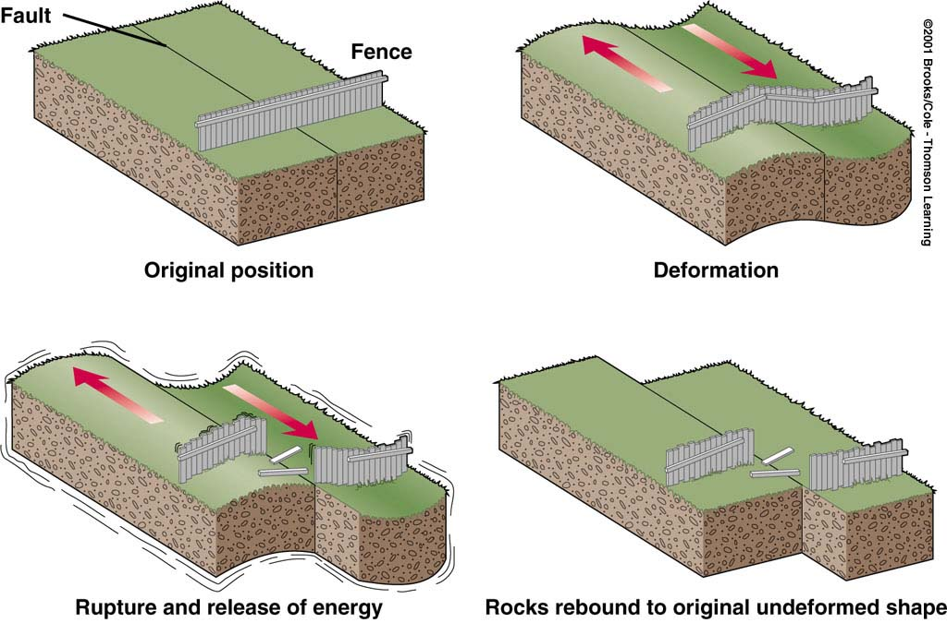
What is the Elastic Rebound Theory?

Slide 8
Elastic Rebound
The sudden return of elastically deformed rock to its original shape
Occurs when more stress is applied to rock than the rock can withstand
Energy is released
Travels as seismic waves, which cause an Earthquake

Slide 9
What is a fault?
A fault is a break in the Earth’s crust along which the blocks of the crust slide relative to one another
Earthquakes occur along faults because of the sliding

Slide 10
Where do Earthquakes occur?
Most take place near the edges of tectonic plates
Earthquakes can occur at:
Convergent Boundaries (Reverse Fault)
Divergent Boundaries (Normal Fault)
Transform Boundaries (Strike-Slip Fault)

Slide 11
Faults at Tectonic Plate Boundaries
Transform = Strike-slip fault
Convergent = reverse fault
Divergent = normal fault

Slide 12
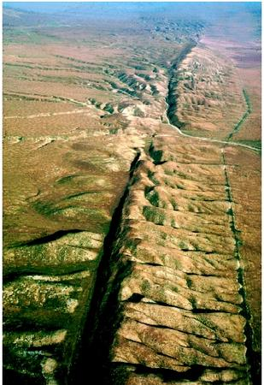
Earthquake Zones
Can happen at Earth’s surface or far below
Earthquakes Zones are places where a large number of faults are located
Ex – San Andreas Fault
Not all faults are on plate boundaries

Slide 13
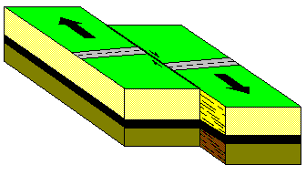
Explain the 3 different types of stresses
Shearing
Rocks move in two opposite directions

Slide 14
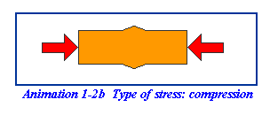
Explain the 3 different types of stresses
Compression
Pushes together

Slide 15
Explain the 3 different types of stresses
Tension
pulls apart

Slide 16
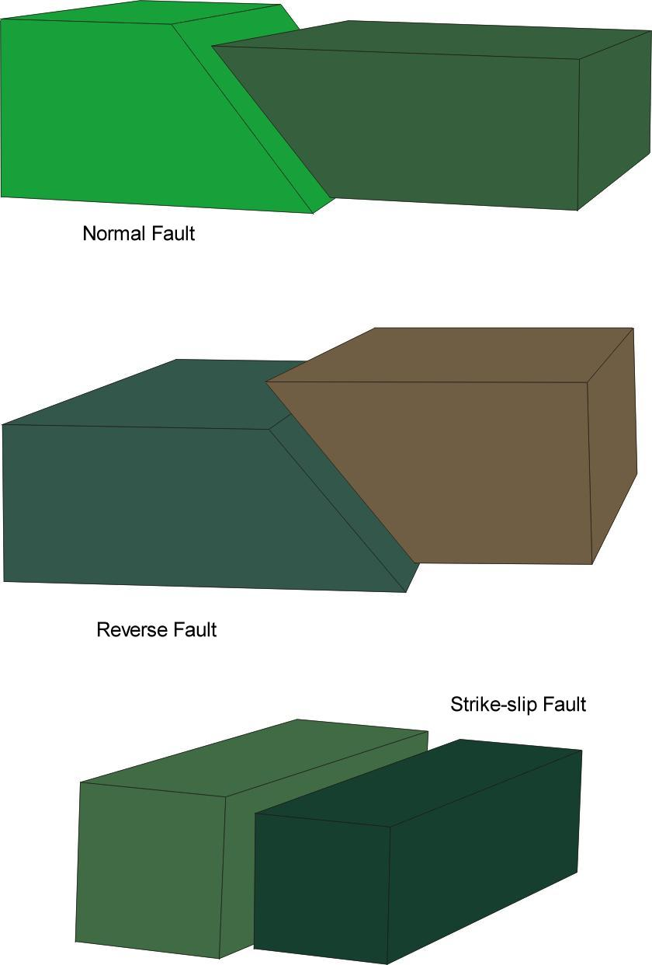
Faults
When enough stress builds up in rock, the rock breaks. This creates a fault.
A fault is where slabs of crust slide past each other.

Slide 17
5. Explain the 3 different types of faults.
Land Plates

Slide 18
5. Explain the 3 different types of faults.
Land Plates

Slide 19
5. Explain the 3 different types of faults.
Land Plates
Indicates forces on the land

Slide 20
5. Explain the 3 different types of faults.
Land Plates
Indicates forces on the land

Slide 21
5. Explain the 3 different types of faults.
Land Plates
Indicates forces on the land

Slide 22
5. Explain the 3 different types of faults.
Land Plates
Indicates forces on the land

Slide 23
5. Explain the 3 different types of faults.
Land Plates
Indicates forces on the land

Slide 24
5. Explain the 3 different types of faults.
Land Plates
This is a Strike Slip Fault
or a Transverse Fault
San Andres Fault
Indicates forces on the land

Slide 25
Fault Types
Plate Motion | Major Fault Type
Transform | Strike-Slip Fault
Divergent | Normal Fault
Convergent | Reverse Fault

Slide 26
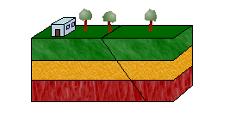
5. Explain the 3 different types of faults.
Normal Fault

Slide 27
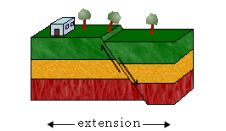
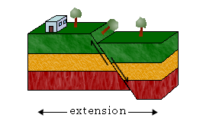
5. Explain the 3 different types of faults.
Normal Fault

Slide 28
5. Explain the 3 different types of faults.
Normal Fault

Slide 29
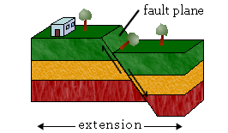
5. Explain the 3 different types of faults.
Normal Fault

Slide 30
5. Explain the 3 different types of faults.
Also called
Scarp face
Normal Fault
The force is called tension

Slide 31
5. Explain the 3 different types of faults.
Reverse Fault

Slide 32
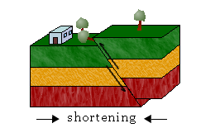
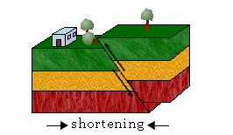
5. Explain the 3 different types of faults.
Reverse Fault

Slide 33
5. Explain the 3 different types of faults.
Reverse Fault
The force pushing is called Compression

Slide 34
How do Earthquakes Travel?
Seismic Waves – waves of energy that travel through the Earth
Body Waves – seismic waves that travel through the Earth’s interior
Two Types:
P Waves
S Waves
Surface Waves – seismic waves that travel along the Earth’s surface

Slide 35
How do Earthquakes Travel?
P Waves
Pressure waves
Waves that travel through solids, liquids, and gases
Fastest waves
Also called primary waves
Move rock back and forth squeezing and stretching the rock
S Waves
Shear waves
Can’t travel through parts of the Earth that are all liquid
Slower than P Waves and arrive later
Also called secondary waves
Stretch the rock sideways, movement is side to side

Slide 36
How do Earthquakes travel?
Surface Waves
Two types
Once produces motion up, down, and around
Other produces back and forth motion
Travel more slowly than body waves and are more destructive

Slide 37
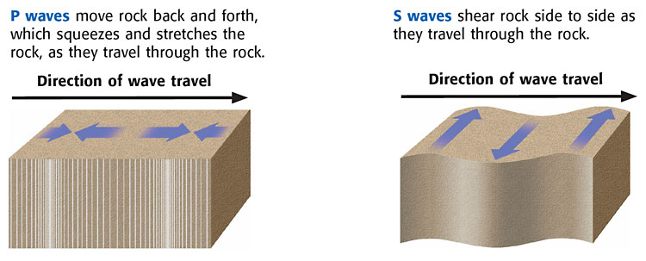

Slide 38
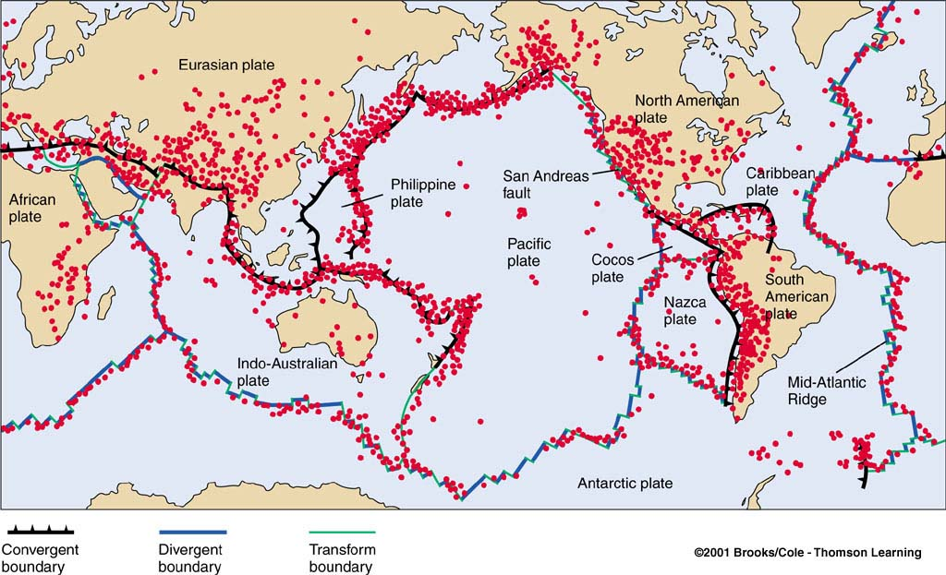

Slide 39
Where Do Earthquakes Occur and How Often?
~80% of all earthquakes occur in the circum-Pacific belt
~15% occur in the Mediterranean-Asiatic belt
~remaining 5% occur in the interiors of plates and on spreading ridge centers
more than 150,000 quakes strong enough to be felt are recorded each year

